Slide 1
BodyFat Percentage Calculator
STAT628
Tuesday
Group 10

Slide 2
Outline
Background
Data Preprocessing
Variable Selection
Model Diagnosis
Result

Slide 3
Background
The body fat percentage (BFP) of a human is defined as the total mass of fat divided by total body mass, multiplied by 100. BFP is of great importance in measuring the well-being of individuals and predicting the risk of illness.
However, the measurement of BFP has faced a trade-off problem between measurement accuracy and approach flexibility for a long time. Some methods that involve underwater measuring may not be generalized to people's daily life, while other methods which must consider a large number of variables neither is an idealized choice.
Therefore finding a method that achieves both simplicity and exactitude in calculating BFP is our ultimate goal in conducting this project.

Slide 4
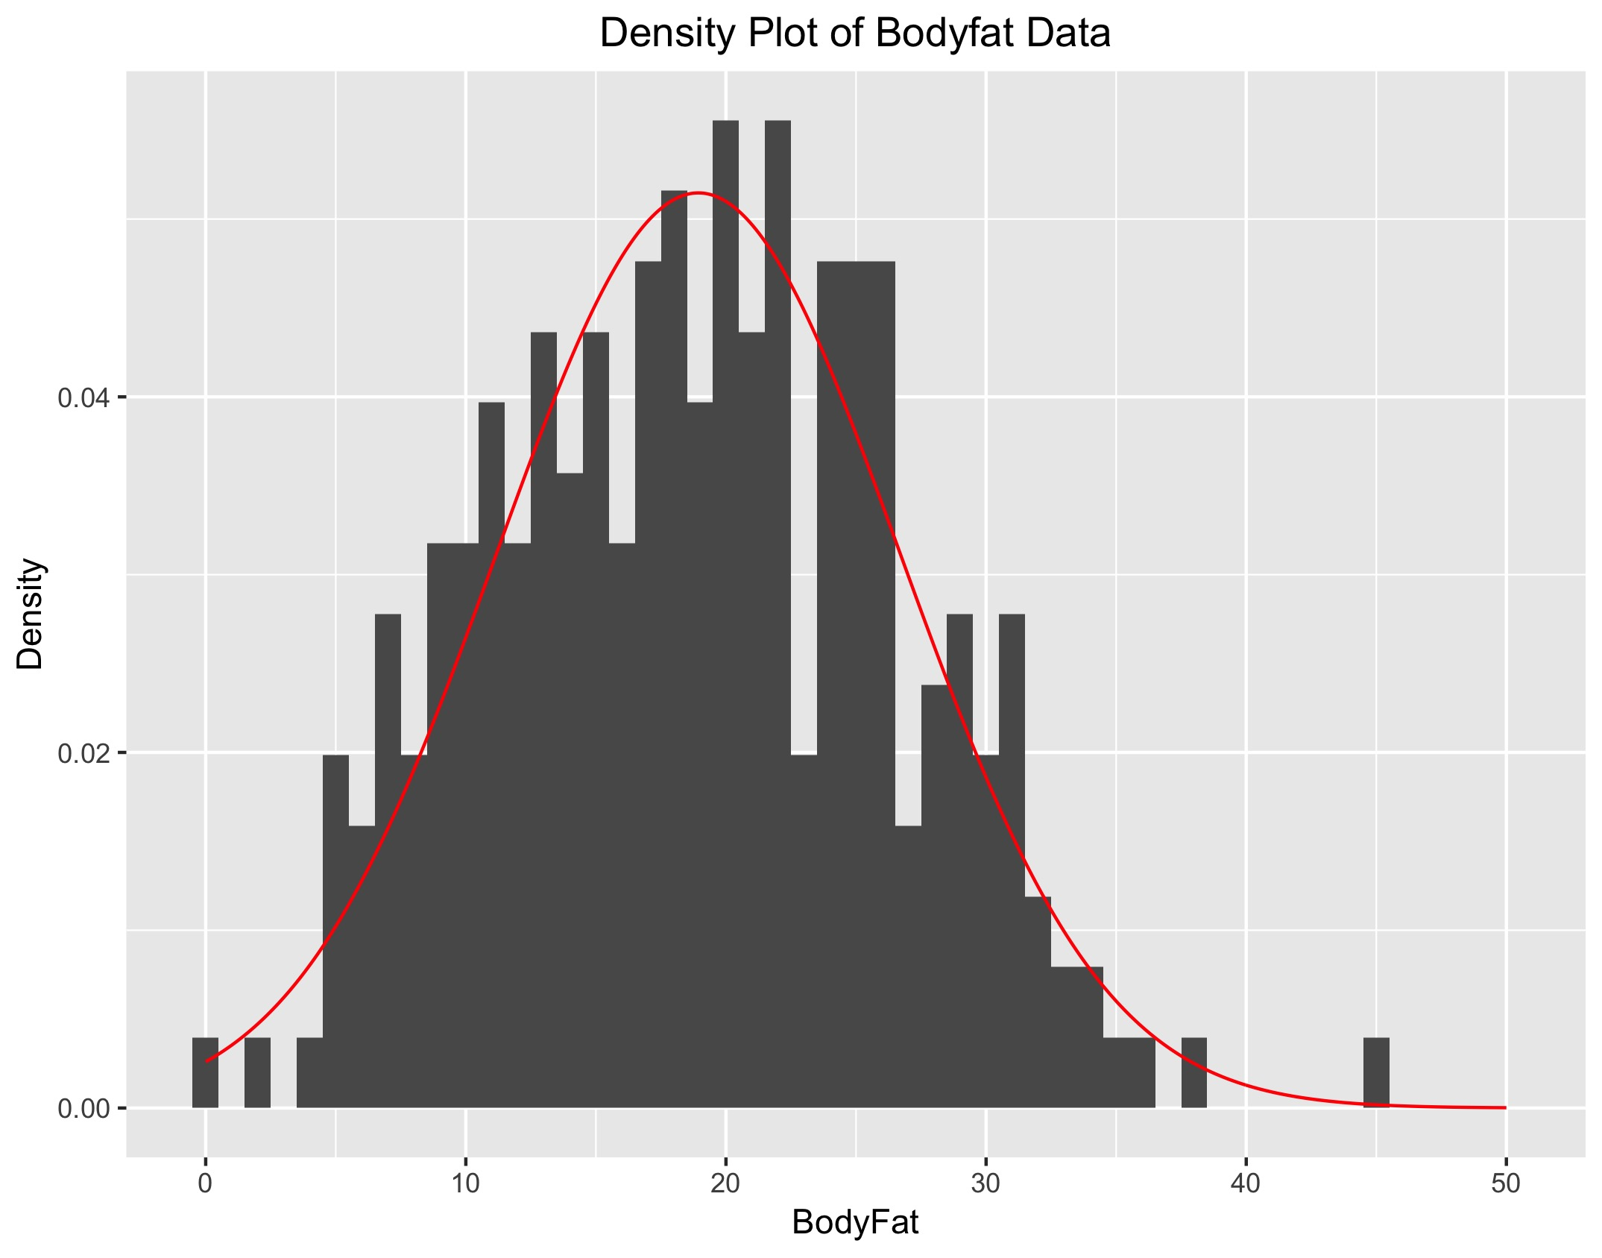
Data Preprocessing
Abnormal observations
Bodyfat dataset
Remove the observations with zero bodyfat
Relationship between density and bodyfat
Relationship between weight, height, and adiposity
Box-plot of other features
Multicollinearity
Normality
Transformation

Slide 5
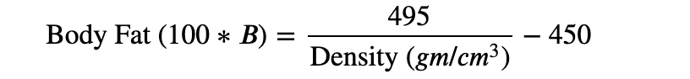
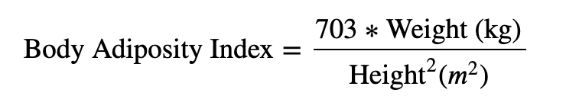
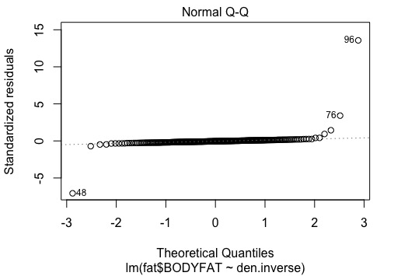
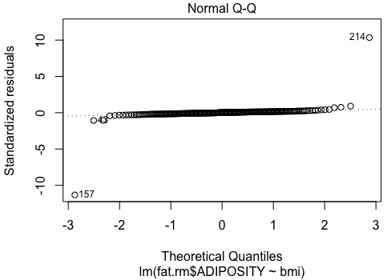
Data Preprocessing
Abnormal observations
Relationship between weight, height, and adiposity
Fit linear regression model
Observations with IDNO=39,41,42 are abnormal.
Abnormal observations
Relationship between density and bodyfat
Fit linear regression model
Observations with IDNO=48,76,96 are abnormal.

Slide 6
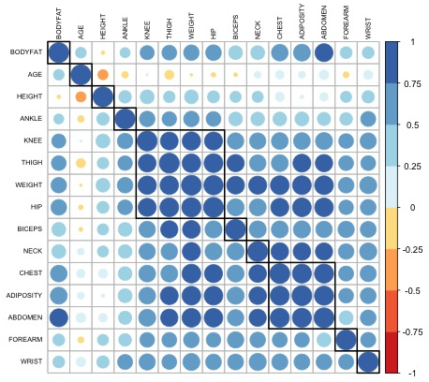
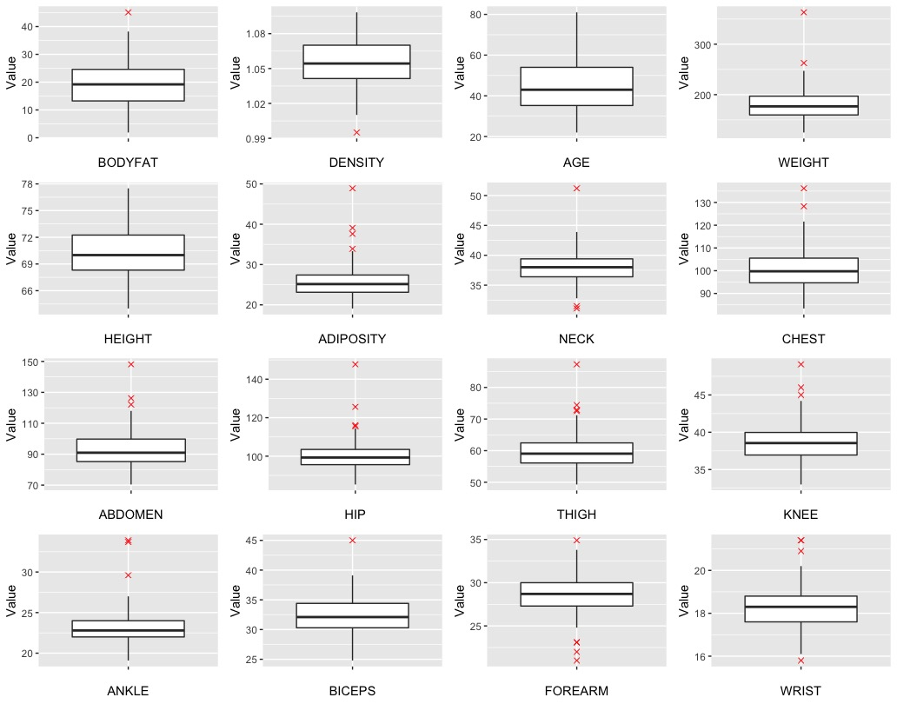
Data Visualization
Abnormal observations
Boxplot of features
Observation with IDNO=39 is abnormal, we choose to keep it.
Multicollinearity
KNEE, THIGHT, WEIGHT, HIP
CHEST,ADIPOSITY,ABDOMEN

Slide 7
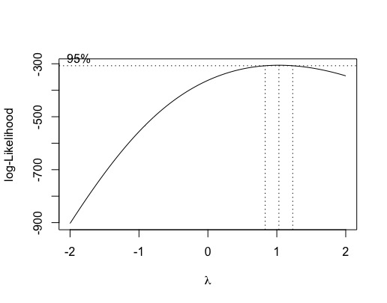
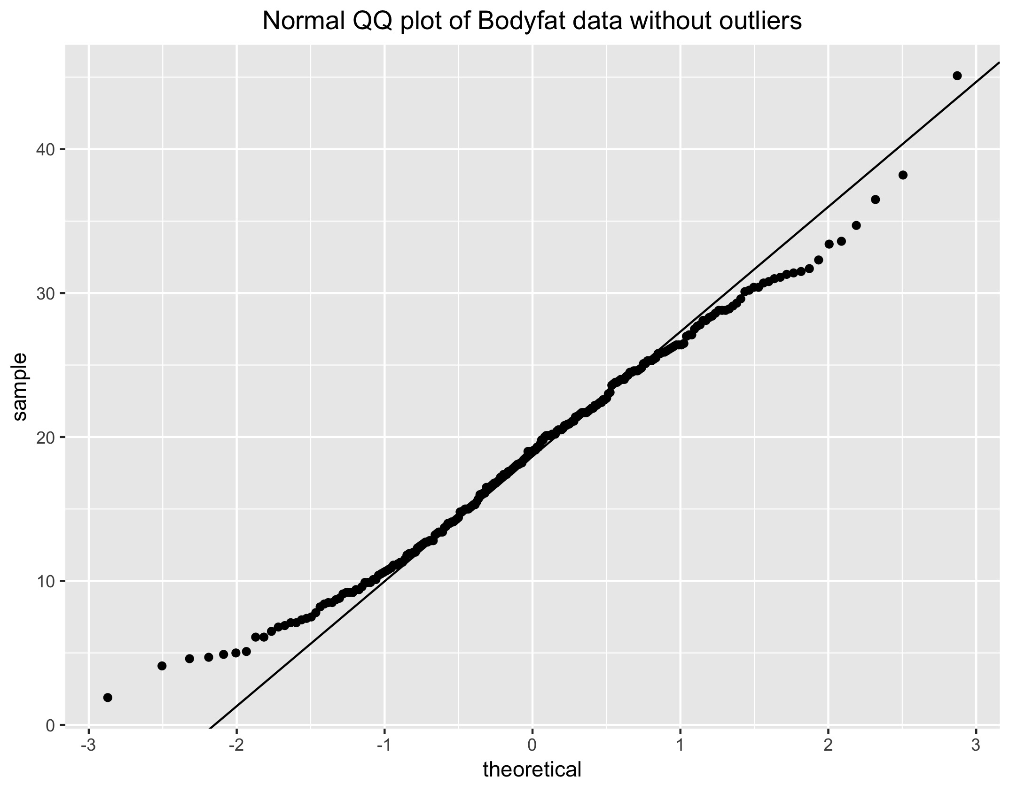
Data Preprocessing
Normality
Normal Q-Q plot of Bodyfat data
Shapiro Test: p-value = 0.1062
Transformation
Box-Cox transformation

Slide 8
Variable selection
Mallow’s Cp
AIC and BIC
Both
Backward
Forward
Fastbw
LASSO
Cross validation
BODYFAT ~ AGE + WEIGHT + HEIGHT + ADIPOSITY +
NECK + CHEST + ABDOMEN + HIP +
THIGH + KNEE + ANKLE +
BICEPS + FOREARM + WRIST

Slide 9
Variable selection
Mallow’s Cp
Result:
BODYFAT~ABDOMEN Adjusted R-squared=0.659
BODYFAT~ABDOMEN+WEIGHT Adjusted R-squared=0.718
BODYFAT~ABDOMEN+WEIGHT+WRIST Adjusted R-squared=0.724
BODYFAT~ABDOMEN+WEIGHT+WRIST+FOREARM Adjusted R-squared=0.731

Slide 10
Variable selection
AIC and BIC
Both :
AIC :BODYFAT ~ AGE + WEIGHT + HEIGHT + ADIPOSITY + NECK +
ABDOMEN + HIP + THIGH +FOREARM + WRIST , Adjusted R-squared: 0.7413
BIC : BODYFAT ~ WEIGHT + ABDOMEN + FOREARM + WRIST , Adjusted R-squared: 0.7318
Backward :
AIC :BODYFAT ~ AGE + WEIGHT + HEIGHT + ADIPOSITY + NECK +
ABDOMEN + HIP + THIGH + FOREARM + WRIST, Adjusted R-squared: 0.7413
BIC : BODYFAT ~ WEIGHT + ABDOMEN + FOREARM + WRIST , Adjusted R-squared: 0.7318
Forward :
AIC :BODYFAT ~ ABDOMEN + WEIGHT + WRIST + FOREARM + NECK +
BICEPS , Adjusted R-squared: 0.7349
BIC : BODYFAT ~ WEIGHT + ABDOMEN + FOREARM + WRIST , Adjusted R-squared: 0.7318

Slide 11
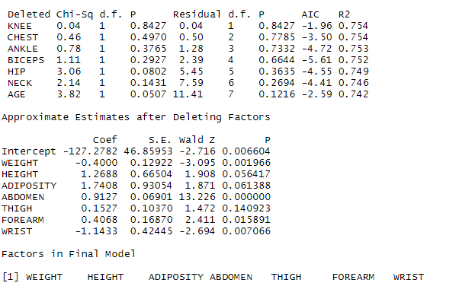
Variable selection
Fastbw
Result:
BODYFAT ~ WEIGHT+HEIGHT+ADIPOSITY+
ABDOMEN+ THIGH +
FOREARM + WRIST

Slide 12
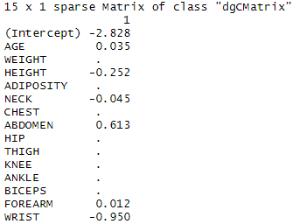
Variable selection
LASSO
Result:
BODYFAT ~ AGE+HEIGHT+NECK+
ABDOMEN+FOREARM + WRIST

Slide 13
Variable selection
According to the methods before,
ABDOMEN, WEIGHT, WRIST, FOREARM
are the most important variable for the final model
Cross validation
BODYFAT ~ ABDOMEN+WEIGHT CV= 17.83583 R^2= 0.7202934
BODYFAT ~ ABDOMEN+WRIST CV= 17.8831 R^2= 0.6990451
BODYFAT ~ ABDOMEN+FOREARM CV= 20.70226 R^2= 0.663109
BODYFAT ~ WEIGHT+WRIST CV= 42.34295 R^2= 0.3893658
BODYFAT ~ WEIGHT+FOREARM CV= 45.97513 R^2= 0.3712991
BODYFAT ~ WRIST+FOREARM CV= 64.60497 R^2= 0.1588935
BODYFAT ~ ABDOMEN+WEIGHT+WRIST CV= 17.57577 R^2= 0.7275847
BODYFAT ~ ABDOMEN+WEIGHT+FOREARM CV= 17.25601 R^2= 0.7255352
BODYFAT ~ WEIGHT+WRIST+FOREARM CV= 42.35037 R^2= 0.3893661
BODYFAT ~ ABDOMEN+WEIGHT+WRIST+FOREARM CV= 16.89677 R^2= 0.7361526

Slide 14
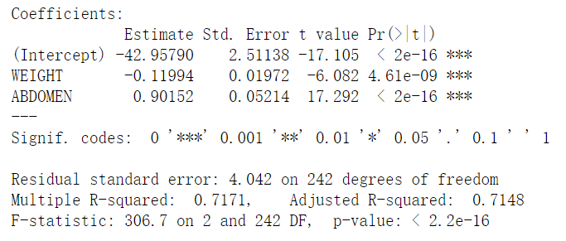
Model Diagnosis
We choose weight and abdomen as predictiors for body fat as our final model.

Slide 15
Model Diagnosis
Advantages: The model is very simple since there are only two variables and it is convenient for users to gain their weight and abdomen data. The multicolinearity has been reduced and the model is robust.
Disadvantages: Since there are only two variables, we sacrificed some accuracy of this model. The model is based on the data of male ones within age 22-81, which means it may not predict females out of the age range well. Besides, there are still some outliers. Meanwhile, the data of users' abdomen may not be as convenient as variables like height and weight to obtain.

Slide 16
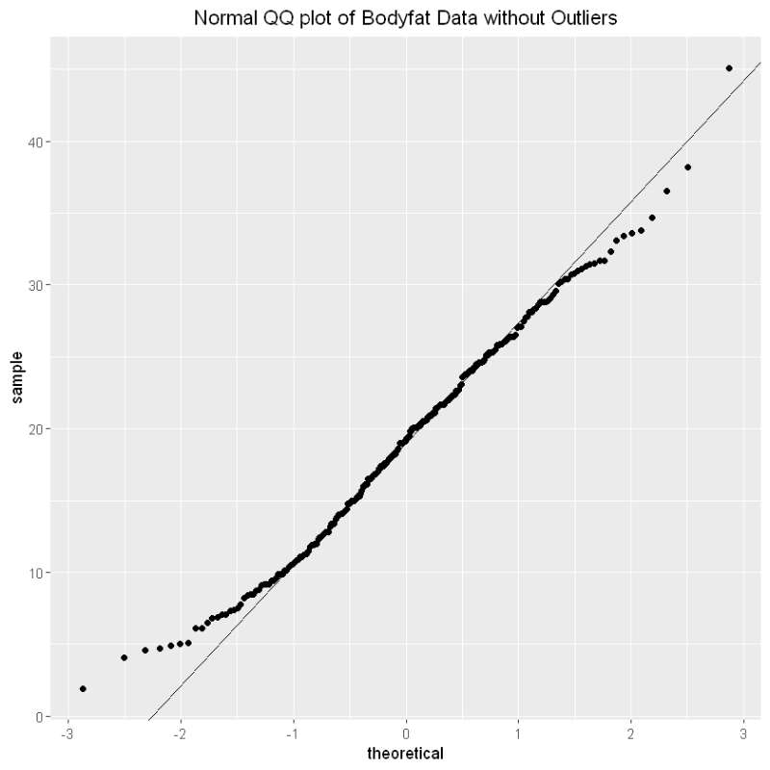
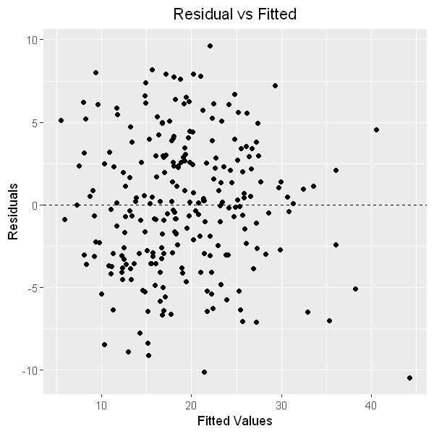
Model Diagnosis
Check the assumptions:
Normality
Linearity
Equal variance
Independence

Slide 17
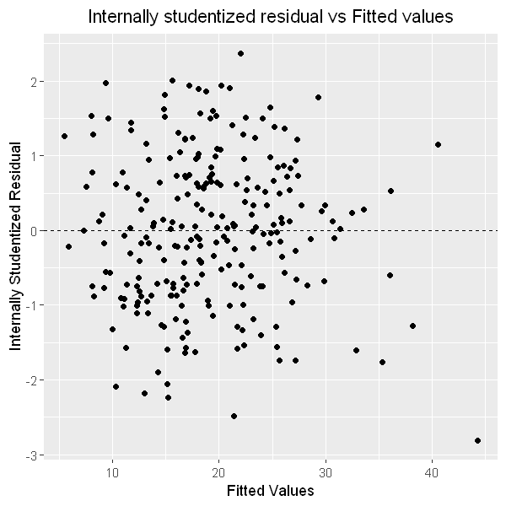
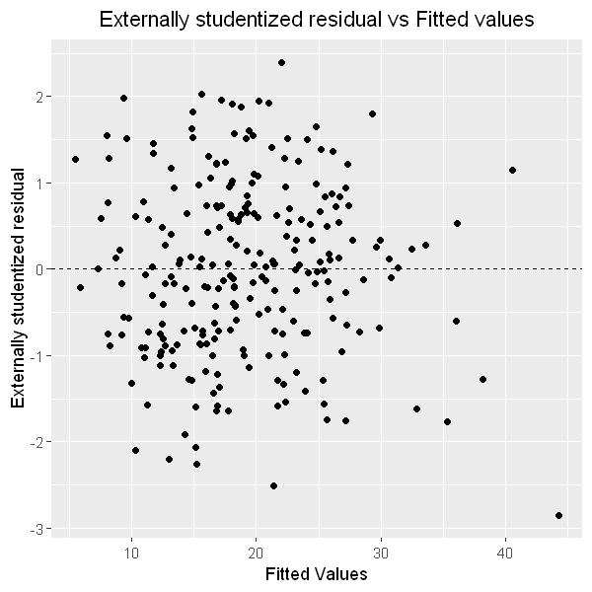


Model Diagnosis
According to the internally and extenally studentized residual vs Fitted values plots, we find no significant outlier.

Slide 18
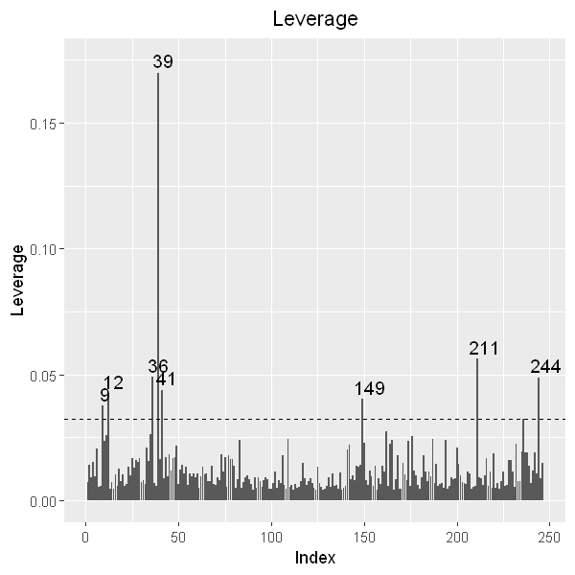
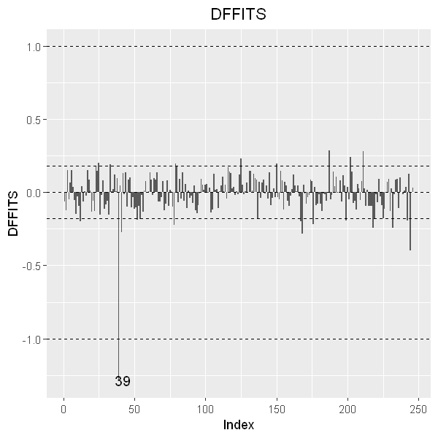

Model Diagnosis
Plots for influential points:
Leverage
DFFITS
Cook's distance
DFBETAS
From the Leverage plot, we find 8 influential points:
9,12,36,39,41,149,211,214
From the DIFFITs plot, we find that the 39th point is influential.
（distance between Xi and the means of the values）
（influence of the i-th observation on i-th fitted value）

Slide 19
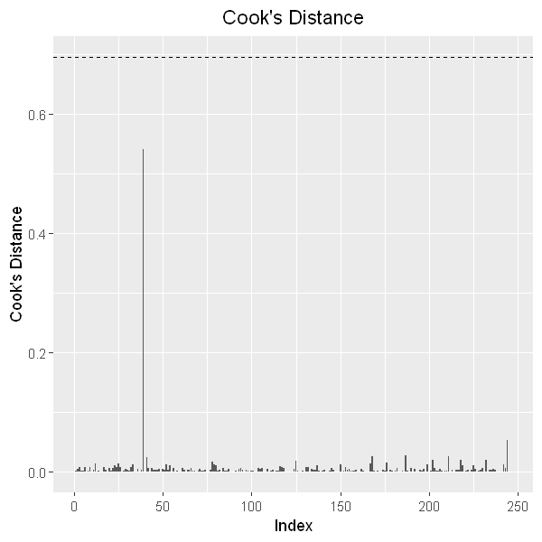
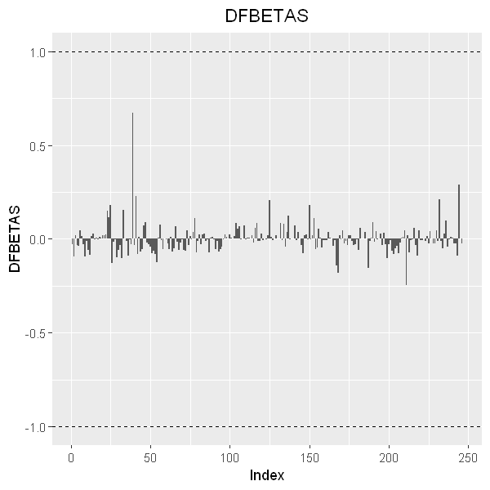


Model Diagnosis
There's no significant influential point shown in Cook's distance and DFBETAS plots. According the the plots, we can see that the 39th point might be an influential outlier.
(the influence of the ith observation on all fitted values)
(the influence of the ith observation on the fitted coefficient 𝛽j )

Slide 20
Result
Our conclusion is that we can predict someone body fat according to his/her weight and abdomen.
The heavier one is, the smaller his/her body fat percentage is. The larger his/her abdomen value is, the larger his/her body fat percentage is.

